Slide 1
XAML performance
Developer's guide to Windows 10 Preview
Andy & Jerry

Slide 2
What is performance?
Progressive rendering
Deferred loading

Slide 3
What is performance?
Startup performance
XAML tree density and complexity
Rendering performance
Including memory consumption
Interactive performance
Including scrolling performance
Workflow performance
Including animations

Slide 4
The visual tree versus the logical tree

Slide 5
Benefits on the universal platform
Memory
Startup

Slide 6
Windows 10 text renders 50% faster

Slide 7

Progressive rendering

Slide 8
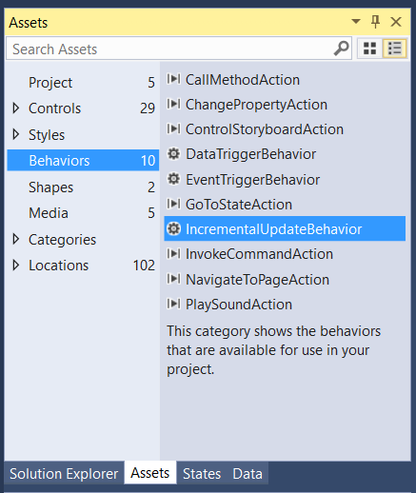
IncrementalUpdateBehavior
Practical ways of handling phases in the CCC event
ContainerContentChanging
<TextBlock Text="{Binding Author}">
<Interactivity:Interaction.Behaviors>
<Core:IncrementalUpdateBehavior Phase="1"/>
</Interactivity:Interaction.Behaviors>
</TextBlock>

Slide 9
Without phases, every element is rendered at once

Slide 10
x:Phase & progressive rendering
<DataTemplate x:DataType="model:FileItem">
<Grid Width="200" Height="80">
<TextBlock Text="{x:Bind DisplayName}" />
<TextBlock Text="{x:Bind prettyDate}" x:Phase="1"/>
</Grid>
</DataTemplate>
Some guidance
Phase "0" is the default
Only a few, manageable phases
Phase numbers don't need to be contiguous

Slide 11

Deferred loading

Slide 12
Understanding deferral
Reduce the number of elements at startup
Declare the UIElement-derived items (or containers) you don't want rendered
4 ways to realize an element
FindName()
EnsureElementRealized()
GetTemplatedChild() (for ControlTemplate)
Storyboard & VisualStates (because of FindName)
Nothing is free
A lightweight proxy element is created
Events are hooked up after realized
Binding is completed after realized (including x:Bind)

Slide 13
The fastest code is the code you don't run

Slide 14
x:Defer example
<StackPanel
x:Name="AdditionalProductPage"
Visibility="Collapsed"
x:DeferLoadStrategy="Lazy">
<!-- so much stuff -->
</StackPanel>

Slide 15
DEFER

Slide 16
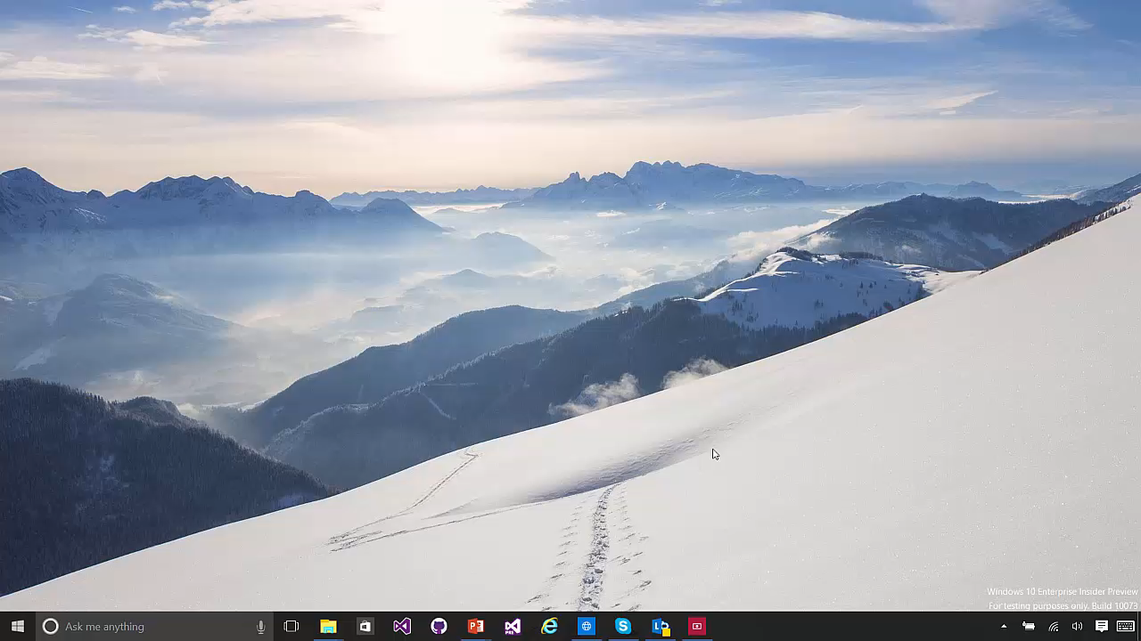

Slide 17
Visual states will realize deferred elements

Slide 18
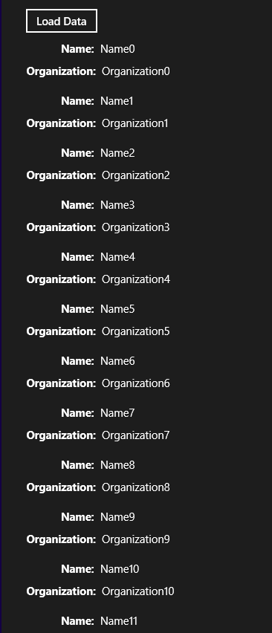
Three types of virtualization
Visual virtualization
The developer does not have to do anything
Data virtualization
Random access virtualization
Incremental virtualization

Slide 19
Databinding sample app

Slide 20
What is performance?
Progressive rendering
Deferred loading

